Slide 1

IBM Data Science Professional Certificate
Applied Data Science Capstone
Project
Mustafa Türköz
https://github.com/mustafaturkoz
29.11.2021

Slide 2
Outline
Executive Summary
Introduction
Methodology
Results
Conclusion
Appendix

Slide 3
Executive Summary
SpaceX Data are collected from public SpaceX API and SpaceX Wikipedia page. New column, labelled as ‘class’ are created which displays successful landings. Data are explored by using SQL, visualization, folium maps, and dashboards. Relevant columns are used as features. All categorical variables are changed via one hot encoding.
Four machine learning models are implemented. These are Logistic Regression, Support Vector Machine, Decision Tree Classifier, and K Nearest Neighbors. The result of these models are similar.

Slide 4
Introduction
The commercial space age is here, companies are making space travel affordable for everyone. There are some companies such as Virgin Galactic, Rocket Lab and Blue Origin. Yet, the best most successful one is SpaceX. The reason behind SpaceX success is relatively inexpensive. SpaceX advertises Falcon 9 rocket launches on its website with a cost of 62 million dollars; other manufacturers’ cost are up to 165 million dollars. There are three stages in regular rockets. Recovering stage of rockets aids reduction which is valid for SpaceX. Space X recovers the first stage.
Space Y aims to compete with SpaceX. Space Y tries to predict successful recovering Stage 1. Now, here we are using machine algorithms to train SpaceX data in order to fulling demands of Space Y as data science team.

Slide 5
Methodology
Executive Summary
Data collection methodology:
SpaceX Data are collected from public SpaceX API and SpaceX Wikipedia page Perform data wrangling
New column labelled as ‘class’ are created which displays true successful landings.
Perform exploratory data analysis (EDA) using visualization and SQL
Perform interactive visual analytics using Folium and Plotly Dash
Perform predictive analysis using classification models
Tuned models via GridSearchCV.

Slide 6
Data Collection
Data Collection process is a combination of API requests from Space X public API and web scraping data from a table in Space X’s Wikipedia entry.
SpaceX API Data Columns:
FlightNumber, Date, BoosterVersion, PayloadMass, Orbit, LaunchSite, Outcome, Flights, GridFins, Reused, Ldegs, LandingPad, Block, ReusedCount, Serial, Longitude, Latitude
Wikipedia Webscrape Data Columns:
Flight No., Launch site, Payload, PayloadMass, Orbit, Customer, Launch outcome, Version Booster, Booster landing, Date, Time

Slide 7
Data Collection - SpaceX API
JSON file + Lists(Launch Site, Booster Version, Payload Data)
Json_normalize to DataFrame data from JSON
Filter data to only include Falcon 9 launches
Cast dictionary to a Data Frame
Replace missing PayloadMass values with mean
Request (Space X APIs)
Dictionary relevant data
Github link: https://github.com/mustafaturkoz/IBM_Data_Science_Professional_Certificate/blob/main/Week_1/jupyter-labs-spacex-data-collection-api.ipynb

Slide 8
Data Collection - Web Scrapping
JSON file + Lists(Launch Site, Booster Version, Payload Data)
Find launch info html table
Cast dictionary to DataFrame
Iterate through table cells to extract data to dictionary
Request Wikipedia
html
Create dictionary
Github link: https://github.com/mustafaturkoz/IBM_Data_Science_Professional_Certificate/blob/main/Week_1/jupyter-labs-webscraping.ipynb

Slide 9
Data Wrangling
Construct new a label to classify landing outcomes where successful equals to 1 and failure equals to 0.
Outcome column has two components: ‘Mission Outcome’ and ‘Landing Location’.
New column ‘class’ has a value 1 when ‘Mission Outcome’ is True else 0 .
A value mapping as follows:
If True ASDS, True RTLS, & True Ocean then 1
If None None, False ASDS, None ASDS, False Ocean, False RTLS then 0
Github link: https://github.com/mustafaturkoz/IBM_Data_Science_Professional_Certificate/blob/main/Week_1/labs-jupyter-spacex-Data%20wrangling.ipynb

Slide 10
EDA with Data Visualization
Exploratory Data Analysis is executed on certain variables Flight Number, Payload Mass, Launch Site, Orbit, Class and Year.
Flight Number vs. Payload Mass, Flight Number vs. Launch Site, Payload Mass vs. Launch Site, Orbit vs. Success Rate, Flight Number vs. Orbit, Payload vs Orbit, and Success Yearly Trend are examined.
In order to investigate relationships of those variables to make decision whether they are informative or not for training machine learning models are scatter plots, line charts and bar plots.
Github link: https://github.com/mustafaturkoz/IBM_Data_Science_Professional_Certificate/blob/main/Week_2/jupyter-labs-eda-dataviz.ipynb

Slide 11
EDA with SQL
Dataset is loaded into IBM DB2 database.
Via SQL Python integration, queries are implemented.
Queries are performed in order to comprehend dataset.
Queries produces information concerning about launch site names, mission outcomes, various pay load sizes of customers and booster versions, and landing outcomes
Github link: https://github.com/mustafaturkoz/IBM_Data_Science_Professional_Certificate/blob/main/Week_2/jupyter-labs-eda-dataviz.ipynb

Slide 12
Build an Interactive Map with Folium
Launch Sites, successful and unsuccessful landings, and a proximity example to major locations: Railway, Highway, Coast, and City are indicated by Folium Map.
Folium Maps mentioned above provides information about Launch Sites location. Moreover, Folium Maps visualize successful landings with respect to location.
Github link: https://github.com/mustafaturkoz/IBM_Data_Science_Professional_Certificate/blob/main/ Week_3/lab_jupyter_launch_site_location.ipynb

Slide 13
Build a Dashboard with Plotly Dash
Pie Chart and Scatter Plot are located in Dashboard.
In order to display individual launch site success rates, pie chart is picked.
Scatter plot gets two inputs:
All sites or individual site
Payload mass on a slider between 0 and 10000 kg
The scatter plot provides us information how success varies across launch sites, payload mass and booster version.
Github link: https://github.com/mustafaturkoz/IBM_Data_Science_Professional_Certificate/blob/main/ Week_3/SpaceX_Dash_App.py

Slide 14
Predictive Analysis (Classification)
Split label 'class' from dataset
GridSearchCV (cv=10) to determine optimal parameters
Fit and Transforms features via Standard Scaler
Split data as train and test
Implement GridSearchCV on Logistic Regression, Support Vector Machine, Decision Tree and KNN models.
Score Test Data
Confusion Matrix For all models
Visualize Scores of Models to compare
Github link: https://github.com/mustafaturkoz/IBM_Data_Science_Professional_Certificate/blob/main/ Week_4/SpaceX_Machine%20Learning%20Prediction_Part_5.ipynb

Slide 15
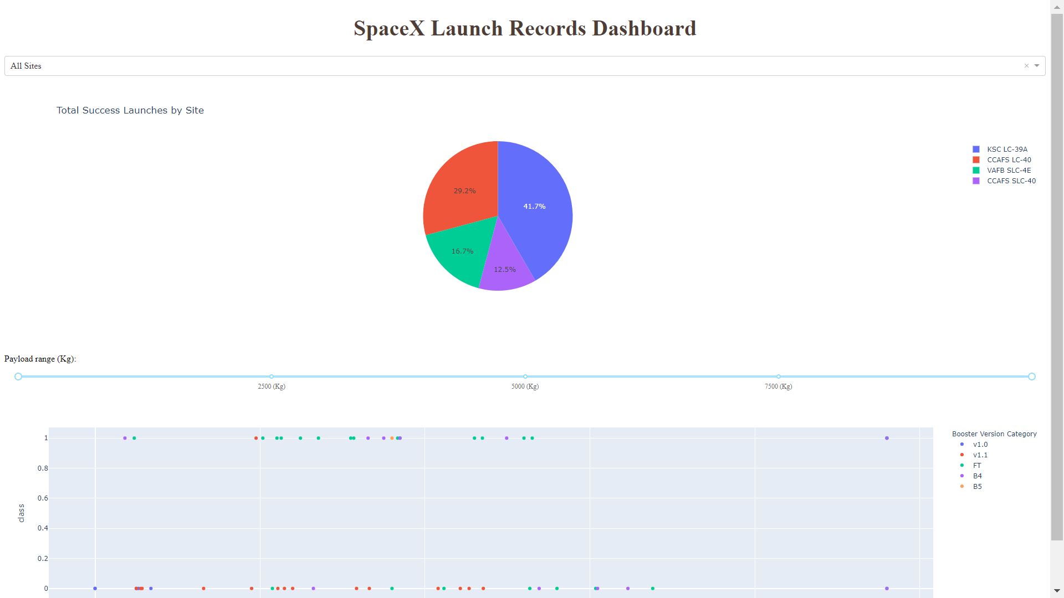
Results
Preview of the Plotly Dashboard

Slide 16
EDA with Visualization
EXPLOTARY DATA ANALYSIS with SEABORN PLOTS

Slide 17
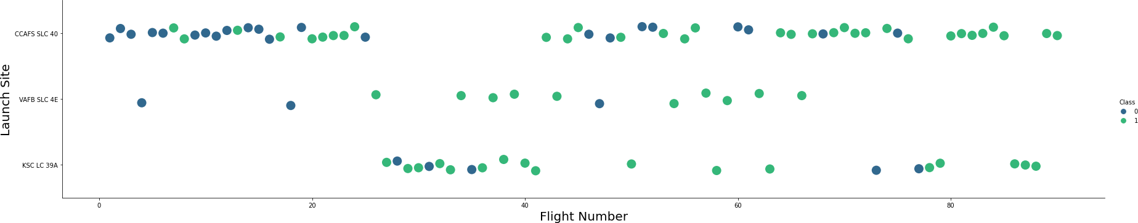
Flight Number vs. Launch Site
Green Dots: Successful Launch
Purple Dots: Unsuccessful Launch
Graph shows that success rate grows over time which is indicated in Flight Number.
CCAAFS seems to be the main launch site as it has the most volume.

Slide 18
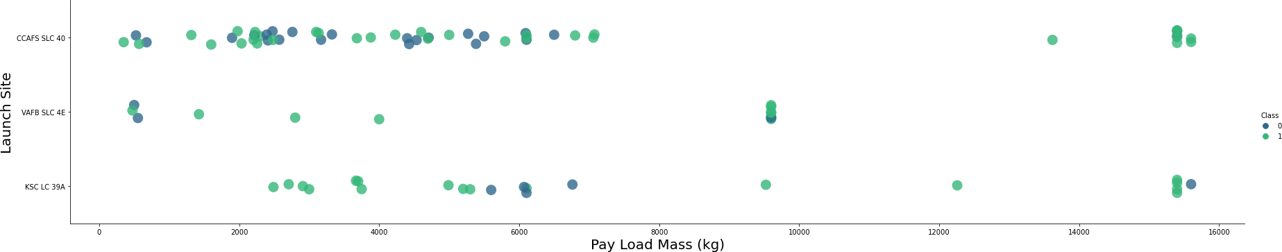
Payload vs. Launch Site
Green Dots: Successful Launch
Purple Dots: Unsuccessful Launch
Payload 0-6000 kg seems likely to fall.
It appears that different launch sites use different payload mass as well.

Slide 19
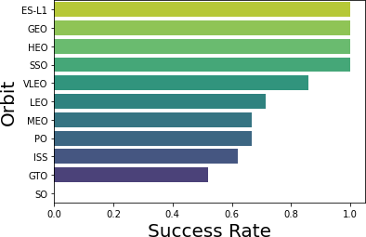
Success Rate vs. Orbit Type
Success Rate Scale with 0 as 0%
0.6 as 60% 1 as 100%
ES-L1 (1), GEO (1), HEO (1) have 100% success rate (sample sizes in parenthesis) SSO (5) has 100% success rate
VLEO (14) has decent success rate and attempts
SO (1) has 0% success rate
GTO (27) has the around 50% success rate but largest sample

Slide 20
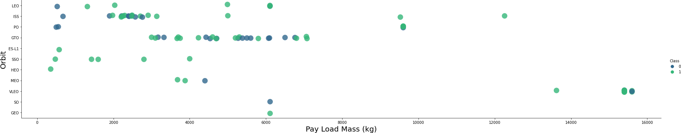
Payload vs. Orbit Type
Green Dots: Successful Launch
Purple Dots: Unsuccessful Launch
Payload mass has correlation with orbit.
LEO and SSO have low Payload Mass relatively.

Slide 21
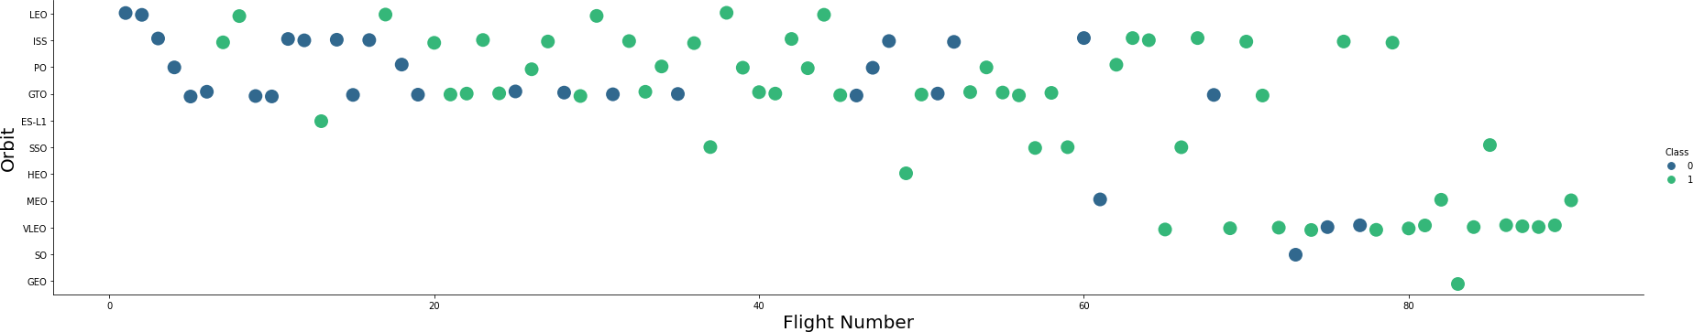
Flight Number vs. Orbit Type
Green Dots: Successful Launch
Purple Dots: Unsuccessful Launch
Launch Orbit preferences changed over Flight Number.
Launch Outcome has correlation with this preference.

Slide 22
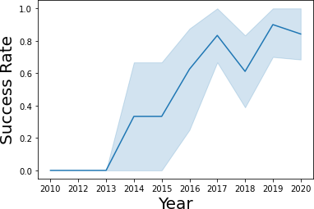
Launch Success Yearly Trend
95% confidence interval (light blue shading)
Generally Success Rate grows yet some local minima occurred around 2018

Slide 23
EDA with SQL
EXPLOTARY DATA ANALYSIS with SQL DB2
INTEGRATED IN PYTHON with SQLALCHEMY

Slide 24
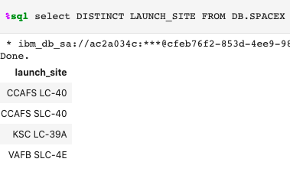
All Launch Site Names

Slide 25
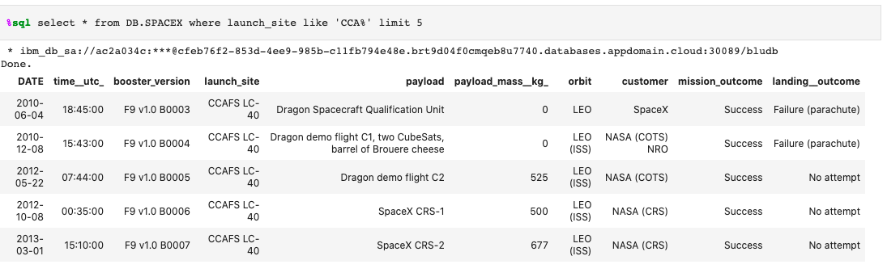
Launch Site Names Begin with 'CCA'

Slide 26
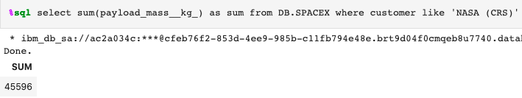
Total Payload Mass
This query sums the total payload mass in kg where NASA was the customer.

Slide 27
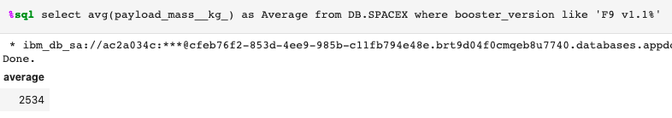
Average Payload Mass by F9 v1.1
This query calculates the average payload mass carried by booster version F9 v1.1

Slide 28
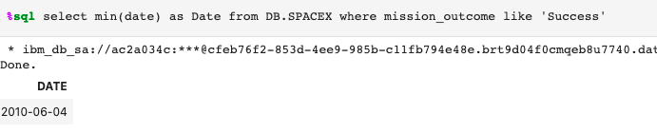
First Successful Ground Landing Date
This query provides the dates of the first successful landing outcome

Slide 29
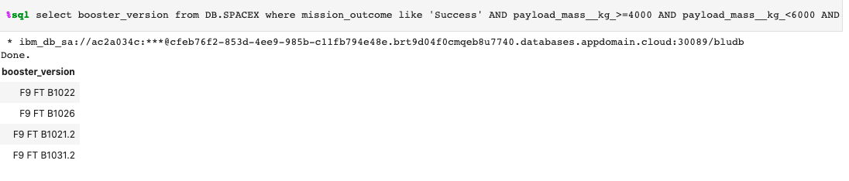
Successful Drone Ship Landing with Payload between 4000 and 6000
This query provides the four booster versions that had successful drone ship landings and a payload mass between 4000 and 6000.

Slide 30
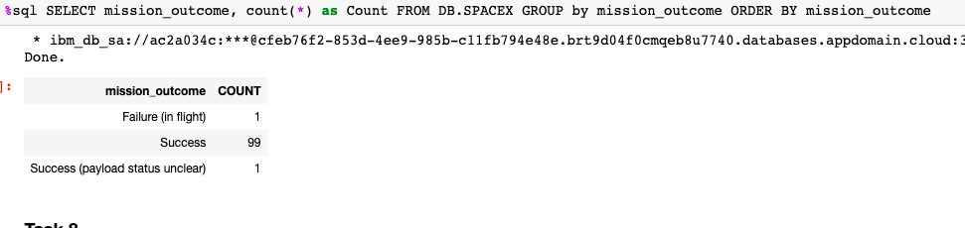
Total Number of Successful and Failure Mission Outcomes
This query gives count of mission outcome.

Slide 31
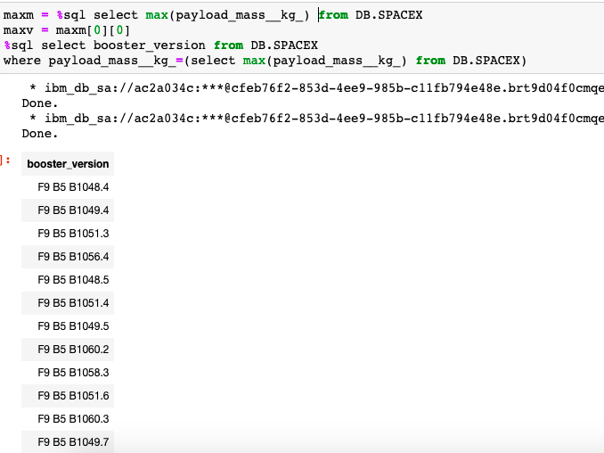
Boosters Carried Maximum Payload

Slide 32
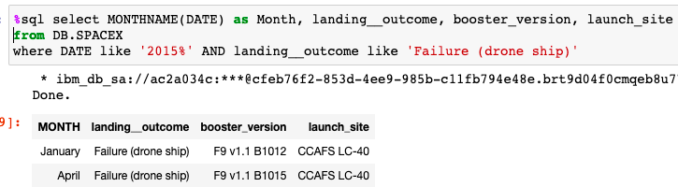
2015 Launch Records
This query produces the Month, Landing Outcome, Booster Version, Payload Mass (kg), and Launch site of 2015 launches where stage 1 failed to land on a drone ship.
There were two such occurrences

Slide 33
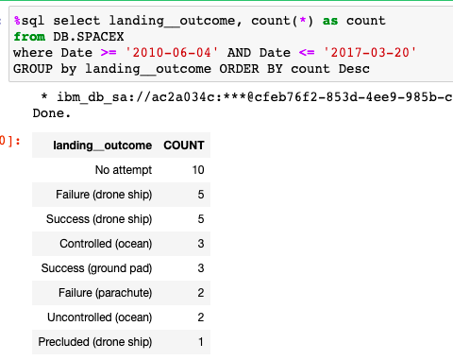
Rank Landing Outcomes Between 2010-06-04 and 2017-03-20
This query returns the count of landing between the date 2010-06-04 and 2017-03-20, in descending order.

Slide 34
Interactive Map with Folium
INTERACTIVE VISUAL ANALYTICS with Folium

Slide 35
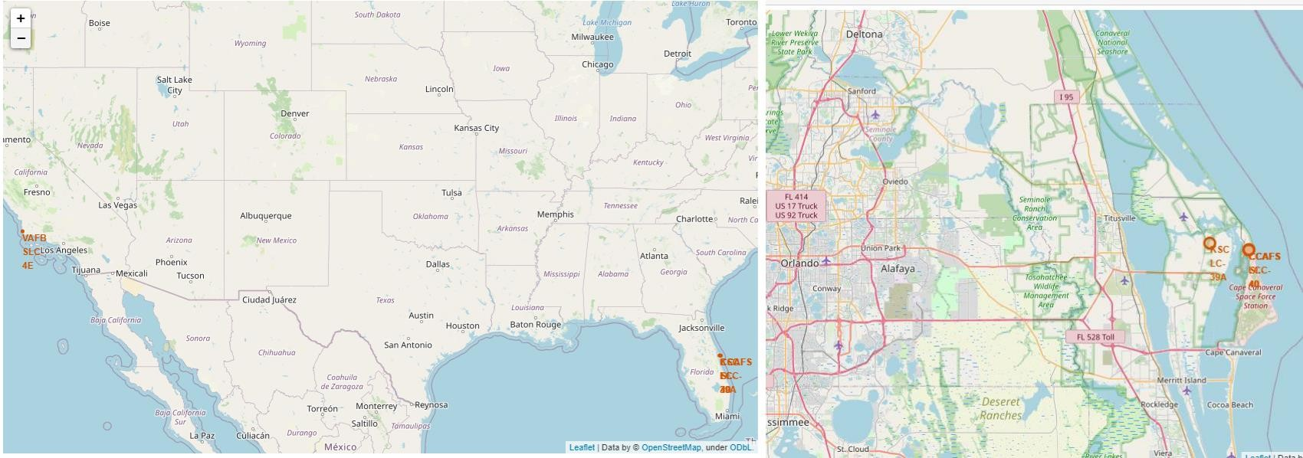
Launch Site Locations
The left map demonstrates all launch sites relative US map. The right map displays the two Florida launch sites since they are very close to each other.

Slide 36
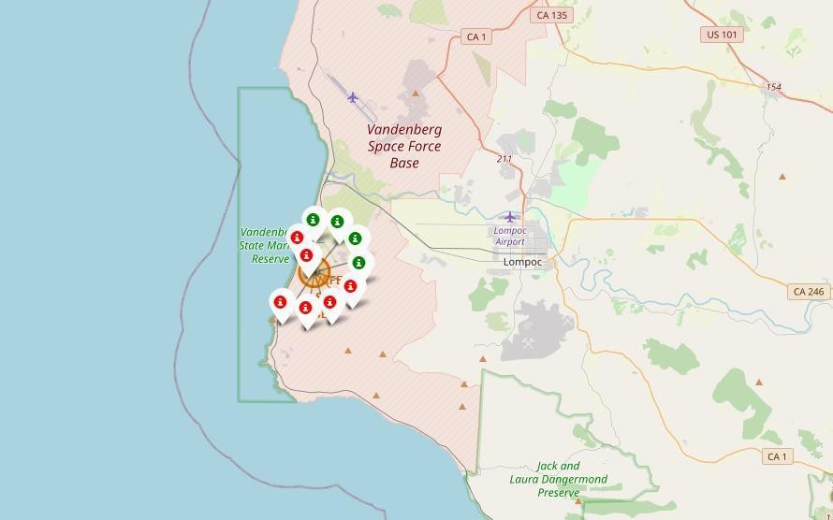
Color-Coded Launch Markers
On Folium Map, Clusters can be taped into to indicate each successful landing (green icon) and failed landing (red icon). In this example, VAFB SLC-4E indicates 4 successful landings and 6 failed landings.

Slide 37
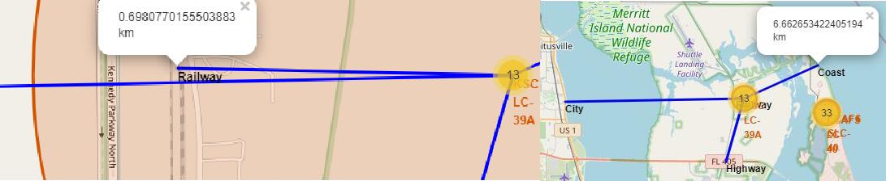
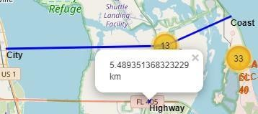
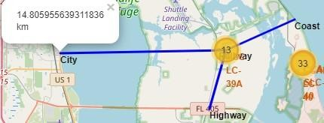
Key Location Proximities
In this example KSC LC-39A, For the most part, launch sites are adjacent to trains and supply transports. Human and supply transportation are easily accessible from launch sites. Launch sites are also close to coasts and relatively far from towns, allowing launch failures to land in the sea rather than in densely populated areas.

Slide 38
Build a Dashboard with Plotly Dash
INTERACTIVE VISUAL ANALYTICS with Ploty Dash

Slide 39
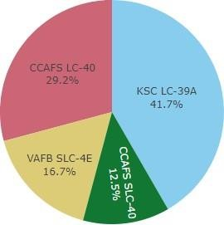

Successful Launches Across Launch Sites
This is the percentage of landings that were successful across all launch sites. CCAFS LC-40 is the old name for CCAFS SLC-40, hence CCAFS and KSC both have the same number of successful landings, although the majority of them happened before the name change. The number of successful landings at VAFB is the fewest. This could be attributed to a smaller sample size and increased launching difficulty on the west coast.

Slide 40
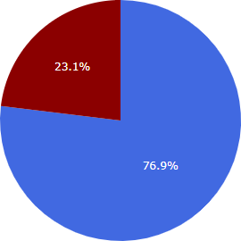

Highest Success Rate Launch Site
With 10 successful landings and 3 failed landings, KSC LC-39A has the best success rate.

Slide 41
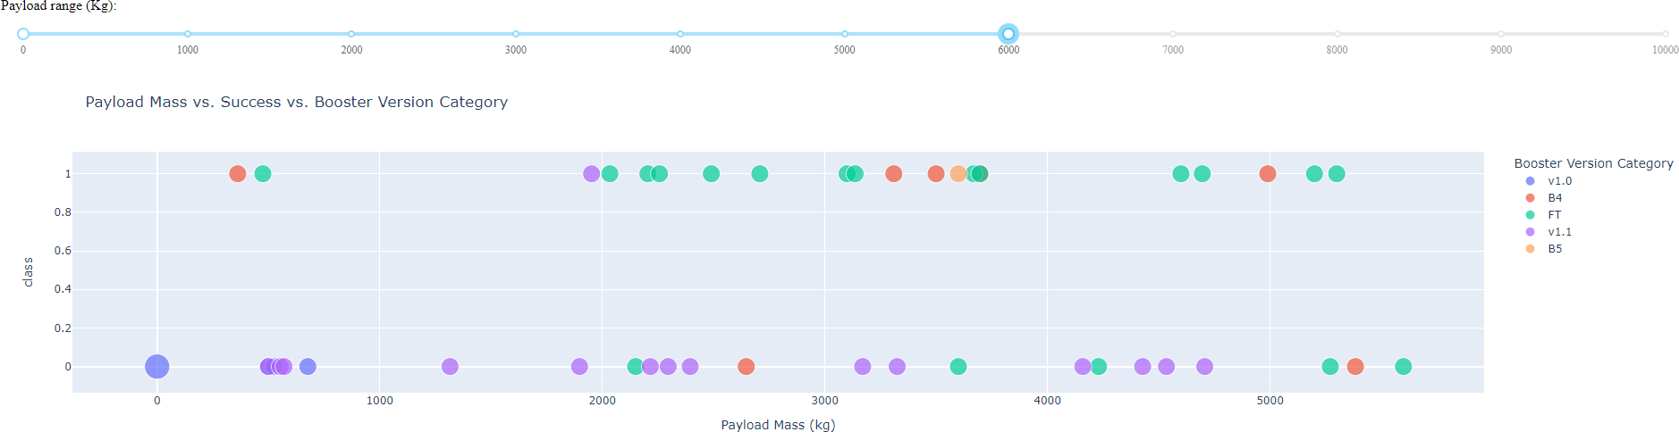
Payload Mass vs. Success vs. Booster Version Category
A Payload range selection is available on the Plotly dashboard. However, instead of the maximum payload of 15600, this is set to a range of 0-10000. A successful landing is indicated by a 1 and a failure by a 0. The booster version category in color and the number of launches in point size are also taken into consideration in the scatter plot. There are two unsuccessful landings with weights of zero kilograms in this exact range of 0-6000.

Slide 42
Predictive Analysis (Classification)
GRIDSEARCHCV(CV=10)
ON LOGISTIC REGRESSION, SVM, DECISION TREE AND KNN

Slide 43
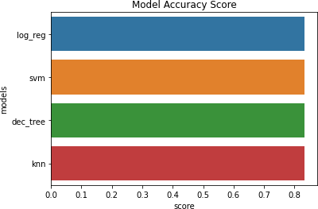
Classification Accuracy
All models have the same accuracy on the test set at 83.33% accuracy.
The sample size of data on test is %18 which is not adequate to distinguish model accuracy.

Slide 44
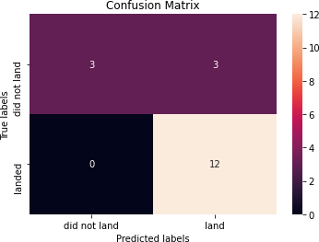
Confusion Matrix
Correct predictions are on a diagonal from top left to bottom right.
Because all models scored equally well on the test set, the confusion matrix is the same for all models.
When the true label was successful landing, the models projected 12 successful landings.
When the true label was failure landing, the models projected three unsuccessful landings.
When the true label was failed landings, the models projected three successful landings (false positives).

Slide 45
Conclusions
In this project, our goal is to create a machine learning model for Space Y, which aims to compete with SpaceX in order to predict when Stage 1 will land successfully to reduce cost approximately $100 million US Dollars.
Data is gained by a public SpaceX API and web scraping SpaceX Wikipedia page.
Data label is generated and stored into DB2 SQL DB.
Interactive Visual Analytical Dashboards are produced via Folium and Plotly Dash.
Logistic Regression, Support Vector Machine, Decision Tree and KNN Machine Learning model with same an accuracy of 83%.
The Stakeholders of Space Y company can use to predict whether wStage1 will land successfully or not.
More data should be collected if at all feasible in order to better established machine learning model and increase accuracy.

Slide 46
Appendix
Github Repository URL:
https://github.com/mustafaturkoz/IBM_Data_Science_Professional_Certificate
Instructors:
Rav Ahuja, Alex Aklson, Aije Egwaikhide, Svetlana Levitan, Romeo Kienzler, Polong Lin, Joseph Santarcangelo, Azim Hirjani, Hima Vasudevan, Saishruthi Swaminathan, Saeed Aghabozorgi, Yan Luo
Special Thanks:
Instructors, IBM and Coursera

